Slide 1

Optimizing Smart City Public Transportation Through Data and Technology
Kethana devi kadiyala
Venkata Sai ram Rohith Mechineni
Deva Sai Vikas Vakkalagadda

Slide 2

Introduction to Modeling and Application of Project Results
Optimizing public transportation enhances mobility, sustainability, and quality of life in smart cities
Applying data science and modeling facilitates evidence-based analysis to guide improvements
Focus area is accurate estimation of bus travel times to inform scheduling and operations
Advanced methods like machine learning offer predictive capabilities not possible manually
Notes:
This introduction highlights why public transit modeling aligns to smart city priorities around mobility, environment, and resident happiness. Data-driven optimization in this area can directly inform better scheduling, routes, and operations based on predicted travel times. Advanced techniques like machine learning are enabling more accurate and granular insights at scale.

Slide 3
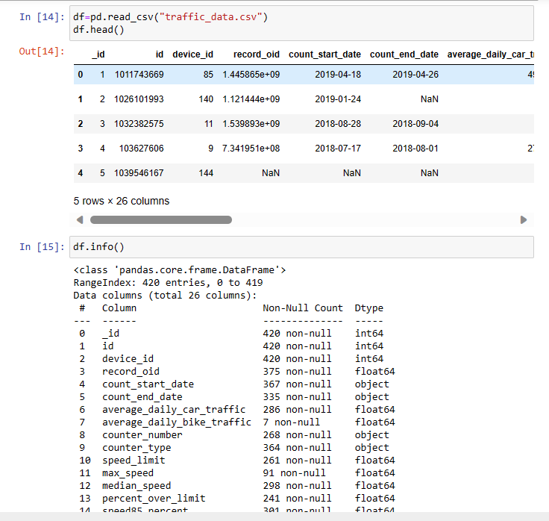
Dataset Overview
Dataset Information:
RangeIndex: 420 entries, 0 to 419
Data columns (total 24 columns)
Data types: int64, float64, object
Memory usage: 77.2+ KB

Slide 4

Data Preparation Phase
Checking data types and converting categorical variables enables correct mathematical operations
Removing duplicate observations reduces distortions in patterns
Splitting raw data purposefully into mutually exclusive training and test sets facilitates model evaluation
Standardizing distinct measures onto a common scale through feature scaling optimizes learning
Imputing missing values through statistical estimates or predictive modeling maintains data integrity
Engineering new explanatory features boosts model exploratory power and accuracy
Assessing and addressing class imbalance allows unbiased model estimation and inference
Documentation of data preprocessing steps maintains analytic provenance and technical debt
Notes:
This covers key aspects of preparing raw data for effective modeling, including cleaning, transforming, splitting, scaling, imputing, feature engineering and handling class imbalance. Maintaining documentation is also vital.

Slide 5
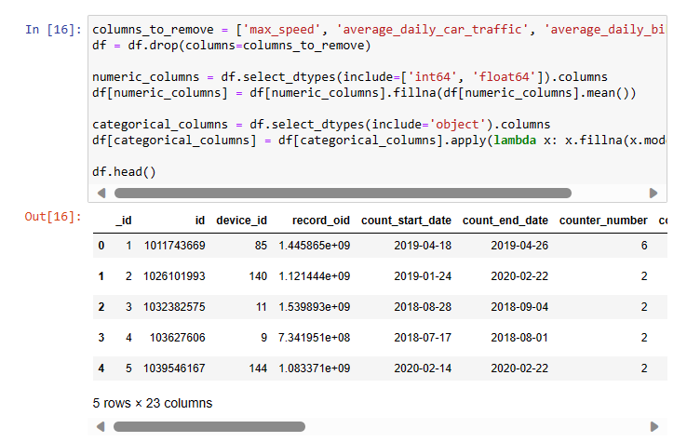
Data Preprocessing
1. Columns Removed:
The columns 'max_speed', 'average_daily_car_traffic', 'average_daily_bike_traffic' were removed to focus on relevant features for clustering.

Slide 6
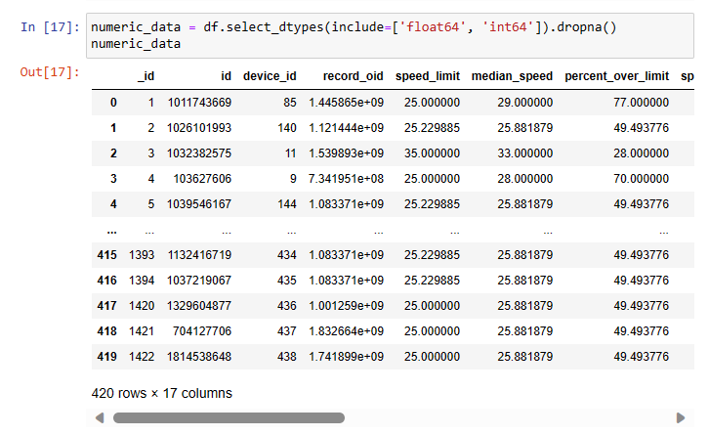
Data Preprocessing
2. Handling Missing Values:
Null values in numeric columns were filled with the mean to maintain data integrity.
Null values in categorical columns were filled with the mode for a representative replacement.

Slide 7
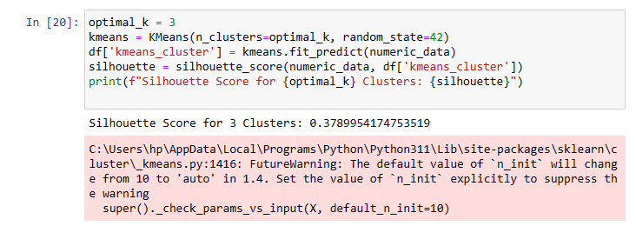
K-Means Clustering
1. Determination of Optimal K:
Utilized the Elbow Method to find the optimal number of clusters (K=3).
Identified a point where additional clusters do not significantly reduce inertia.
2. K-Means Clustering:
Applied K-Means clustering with K=3 to group data points.
Silhouette Score for K-Means: 0.379, indicating a reasonable separation between clusters.

Slide 8
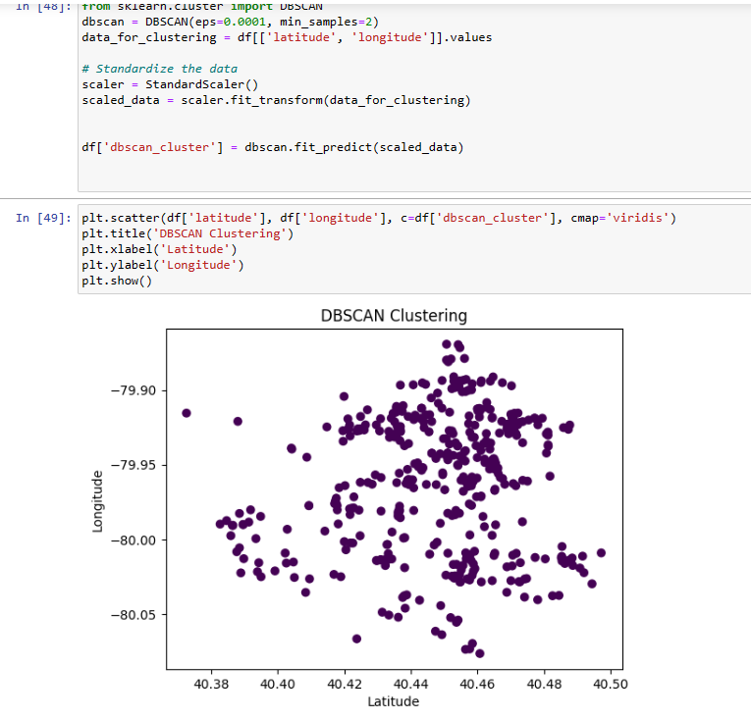
DBSCAN
1. DBSCAN Clustering:
Applied DBSCAN with specified parameters to detect dense regions.
Visualized clusters using a scatter plot.
Issue: DBSCAN assigned only one label, indicating potential challenges in identifying distinct clusters.

Slide 9
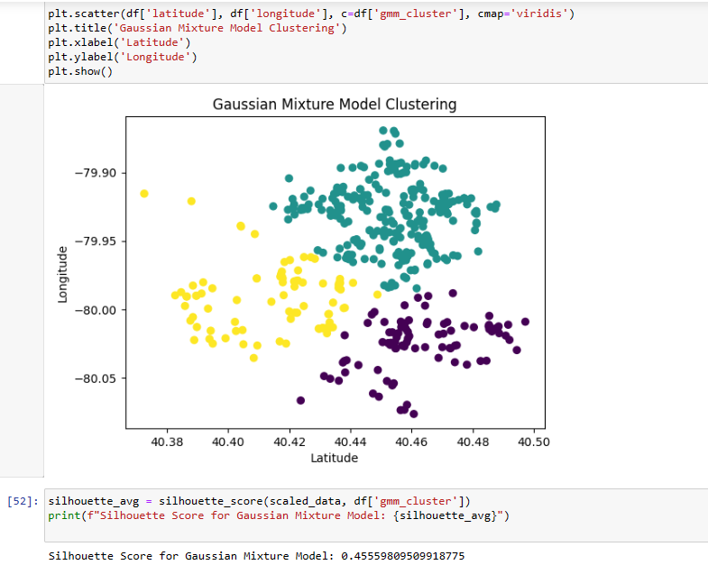
Gaussian Mixture Model (GMM)
GMM Clustering:
Applied Gaussian Mixture Model (GMM) with 3 components.
Visualized clusters using a scatter plot.
Silhouette Score for GMM: 0.456, indicating a good separation between clusters.

Slide 10
Model Optimization
Tune
Tune hyperparameters like learning rate, tree depth for precision improvements
Explore
Explore neural networks, support vector machines for non-linear relationships
Customize
Customize framework with project KPIs and domain-specific constraints
Notes:
Recommendations for tuning and additional advanced model types to explore.

Slide 11
Model Deployment
Containerization using Docker for smooth portability across environments
Instrumentation with Prometheus for monitoring key performance metrics
Jenkins pipeline for retraining models on new data
Notes:
Technical deployment considerations - Docker, Prometheus, Jenkins.

Slide 12

Recommendations
Optimal Clustering Method:
K-Means and GMM appear suitable for this dataset. Consider the application requirements and the characteristics of the clusters.
DBSCAN Adjustment:
Revisit DBSCAN parameters for better cluster identification.
Further Analysis:
Explore additional features or advanced techniques for improved clustering performance.
Notes:
Measuring operational improvements across service delivery, asset usage and customer experience.

Slide 13
Conclusion
Rigorous data preprocessing, model evaluation and monitoring drives optimization
Cross-functional coordination on deployments and IT infrastructure
Continued enhancements guided by quantifiable metrics tracking
Notes:
Recap of key concepts and recommendations.

Slide 14
Conclusion
K-Means and GMM:
Both K-Means and GMM demonstrated meaningful cluster separation with silhouette scores, suggesting robust results.
Hierarchical Clustering:
Hierarchical clustering showed a lower silhouette score, indicating less distinct separation compared to K-Means and GMM.
DBSCAN:
DBSCAN faced issues, possibly due to the nature of the data or parameter settings. Further investigation is needed.

Slide 15
Thank You

